Slide 1
Pervasive Computing
Lab 3

Slide 2
Agenda
Intents & Navigation
Activity life cycle
TODO List Application:
ListViews
GridView
Customizing List View

Slide 3

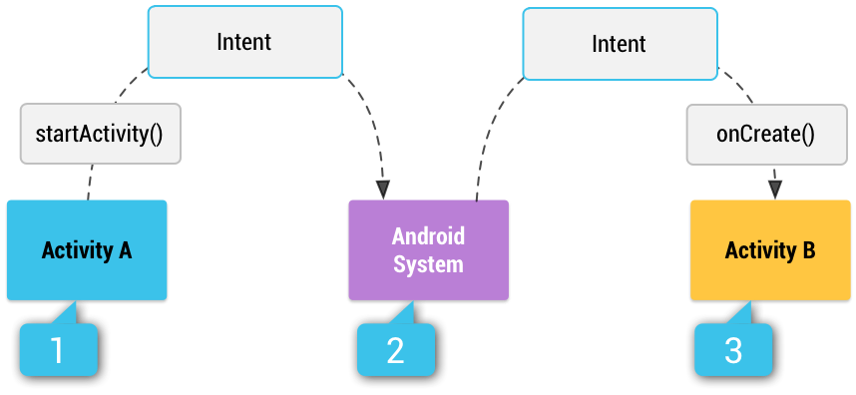
Intents & Navigation
Intent is a messaging object that is used allow different components within an app to request functionality or data from other components.
it serves as a bridge between different components of an application and ease communication between different apps on an Android device.

Slide 4
Explicit and implicit intents
Explicit Intents:
Used to start a specific component within the same app (starting a new activity).
Intent i = new Intent(this, ViewShoppingCart.class);
startActivity(i);
Implicit Intents:
Used to activate components from other apps to perform a particular action (opening a web page).
Intent i = new Intent(Intent.ACTION_VIEW, Uri.parse("http://www.vogella.com"));

Slide 5
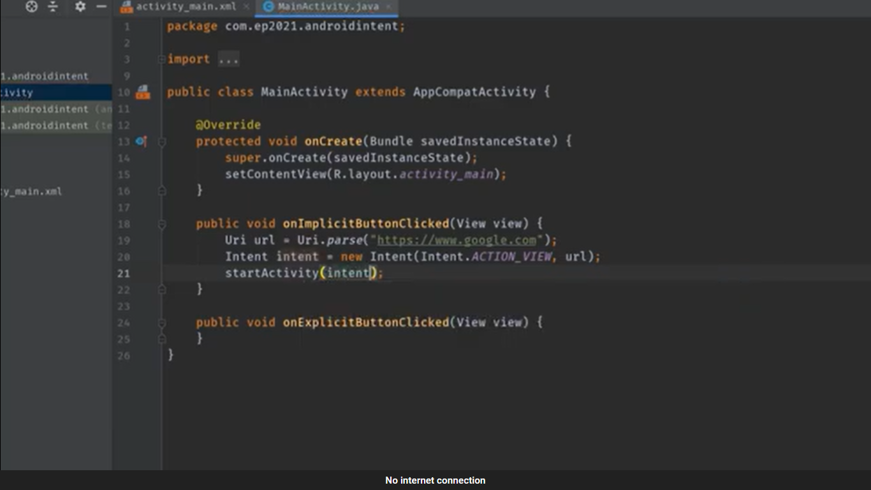
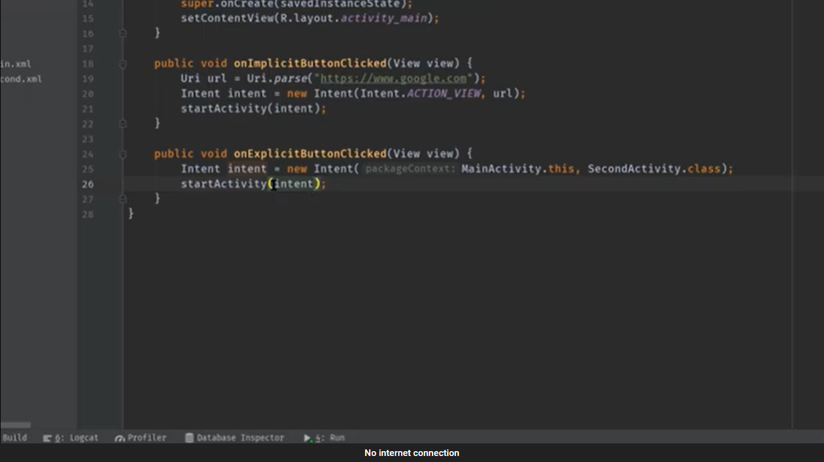
Explicit and implicit intents

Slide 6
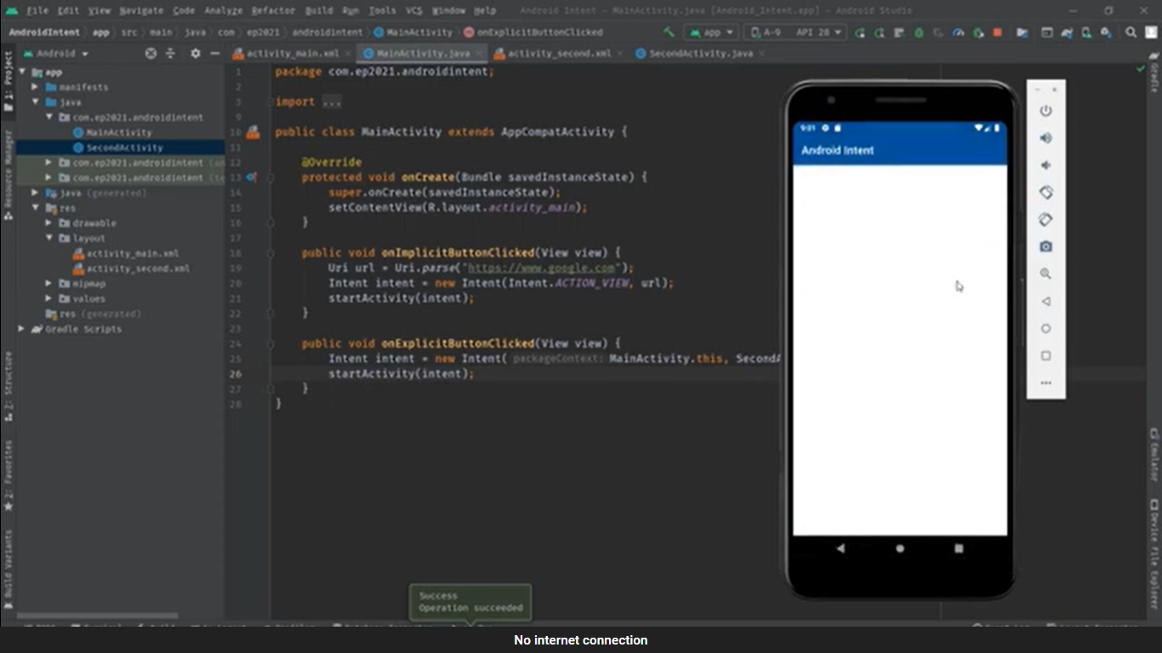
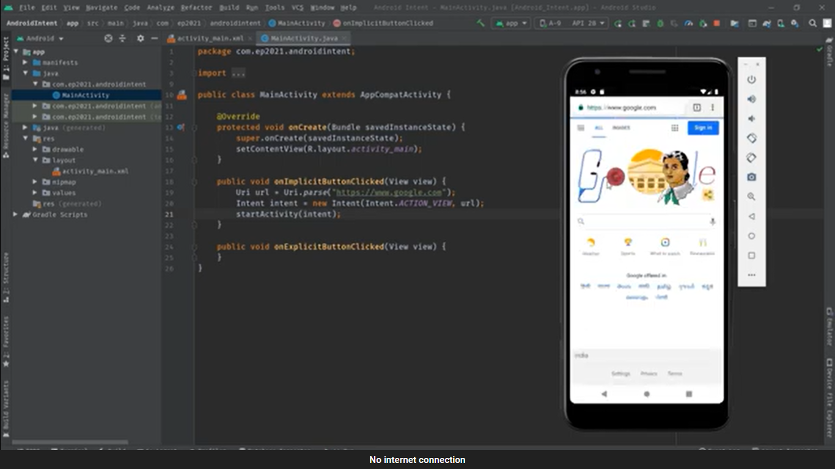
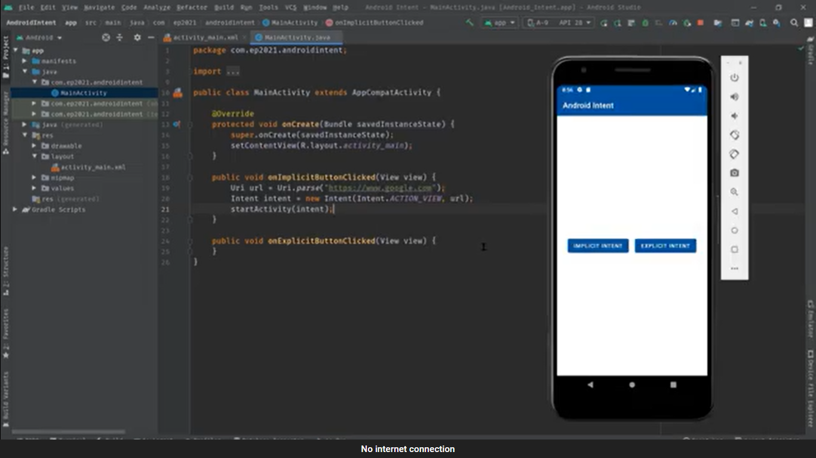
Explicit and implicit intents

Slide 7
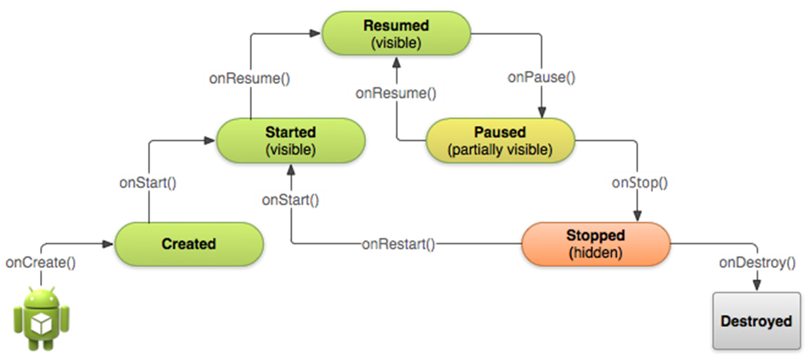
Activity Life Cycle:

Slide 8
Activity Life Cycle:
Created (not visible yet)
Started (visible)
Resume (visible)
Paused(partially invisible)
Stopped (hidden)
Destroyed (gone from memory)
State changes are triggered by user action, configuration changes such as device rotation, or system action

Slide 9
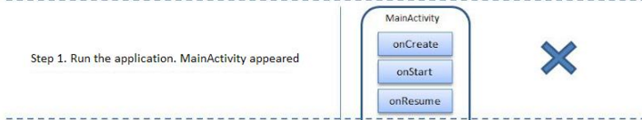
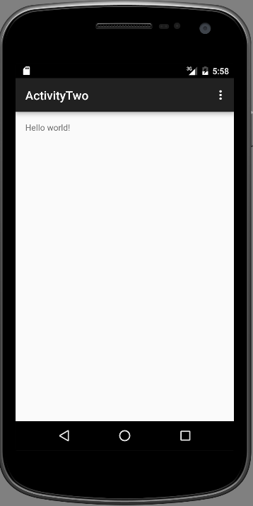
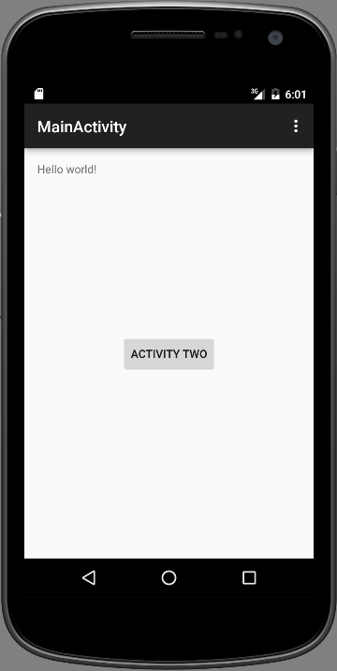
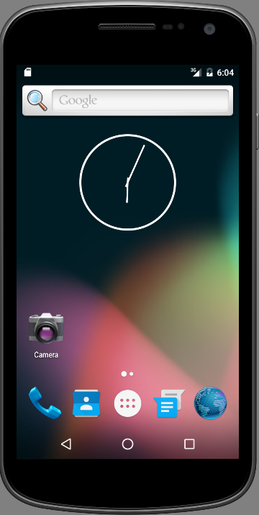
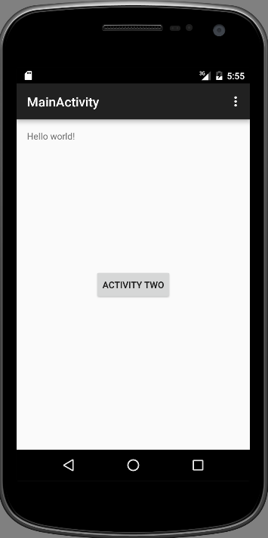
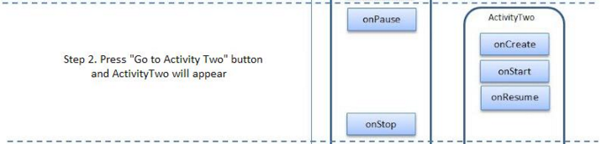
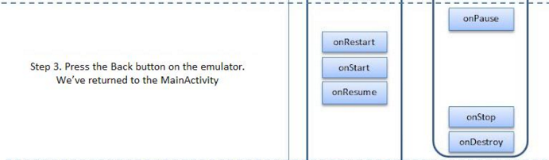
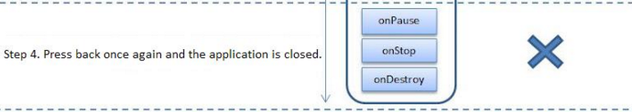
Activity Life Cycle:

Slide 10
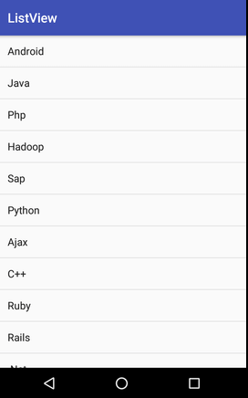
List View
List View is a View Group that creates a list of scrollable items.

Slide 11
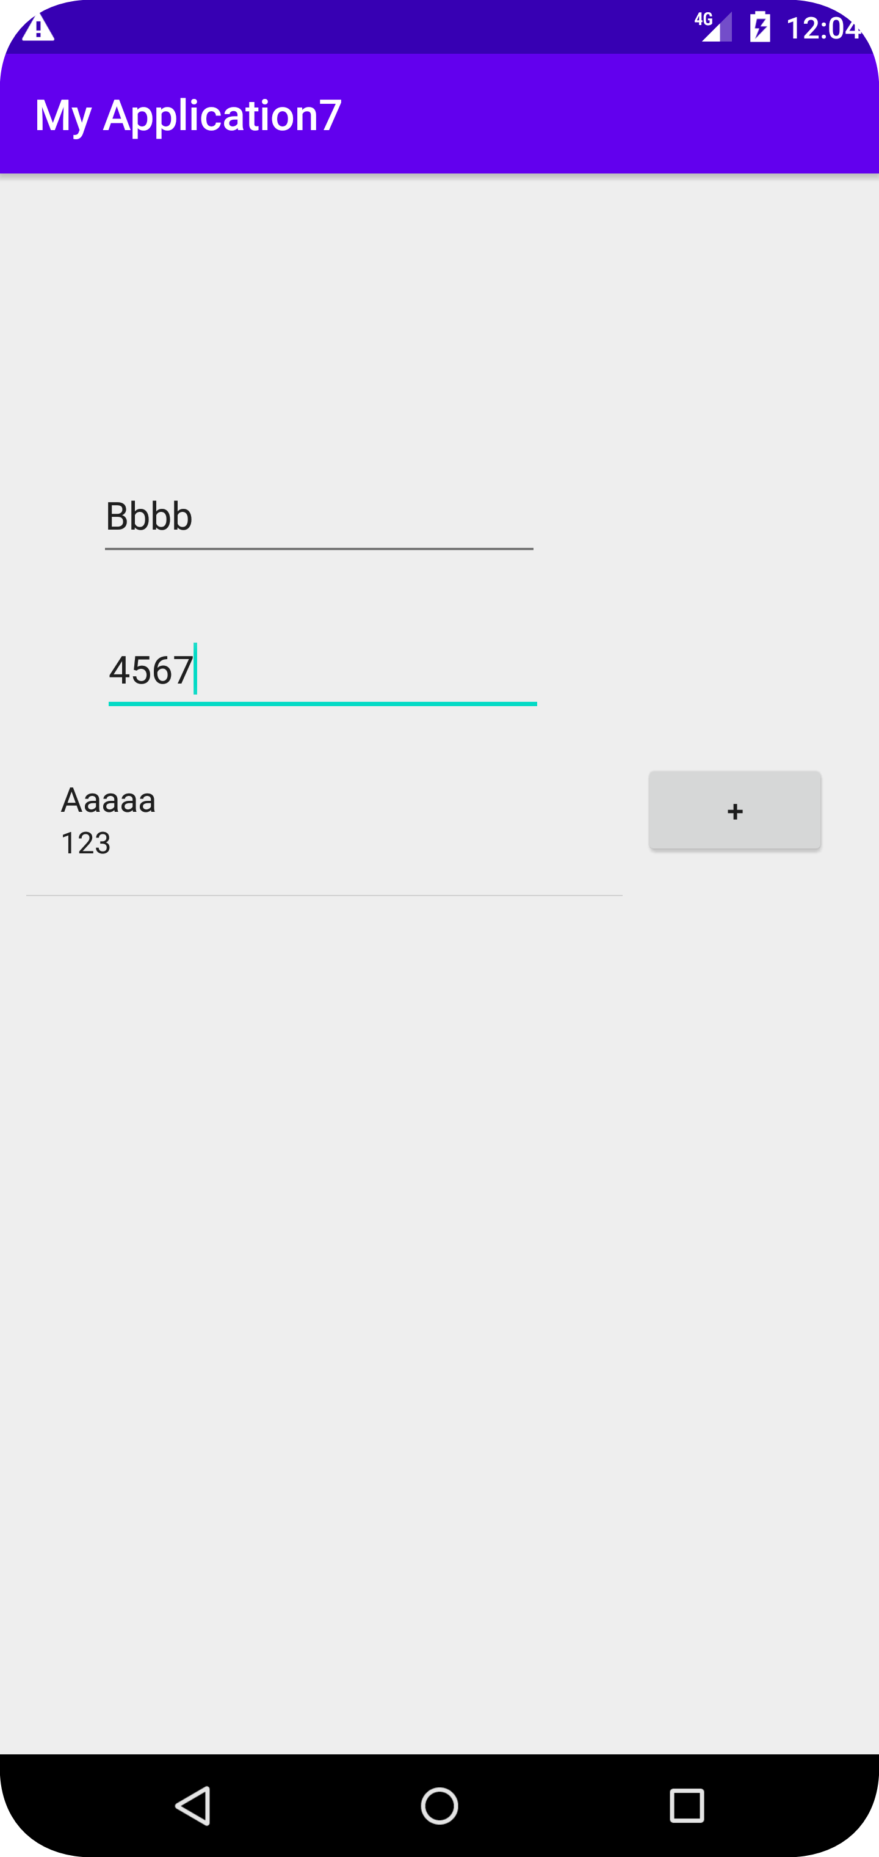
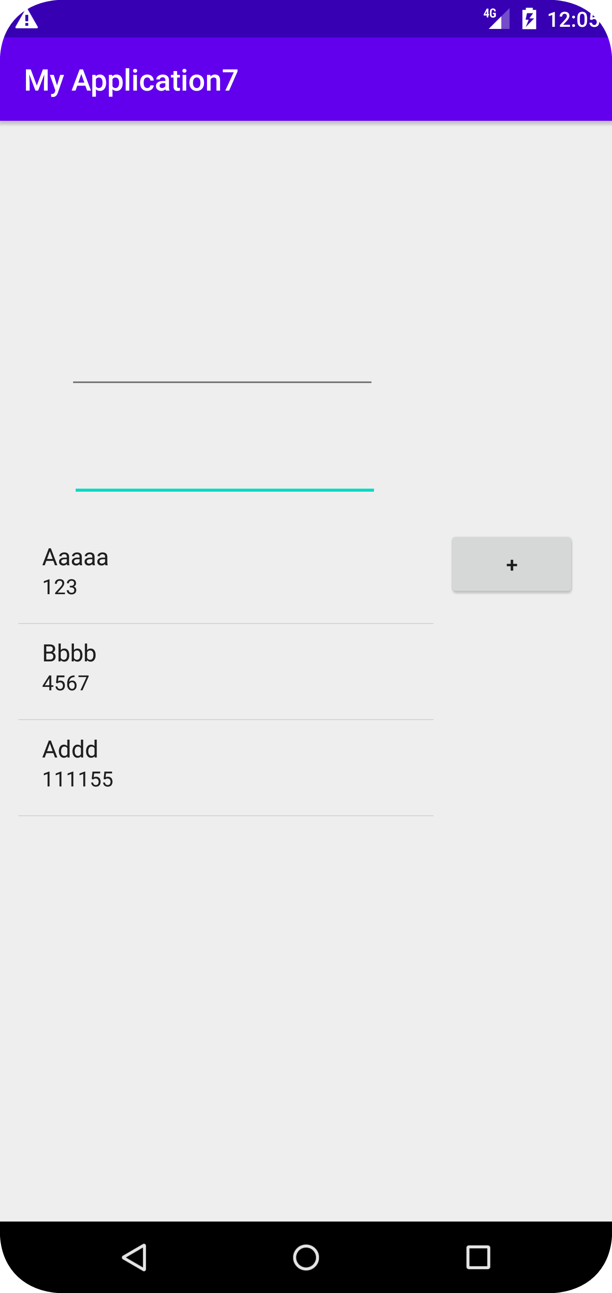
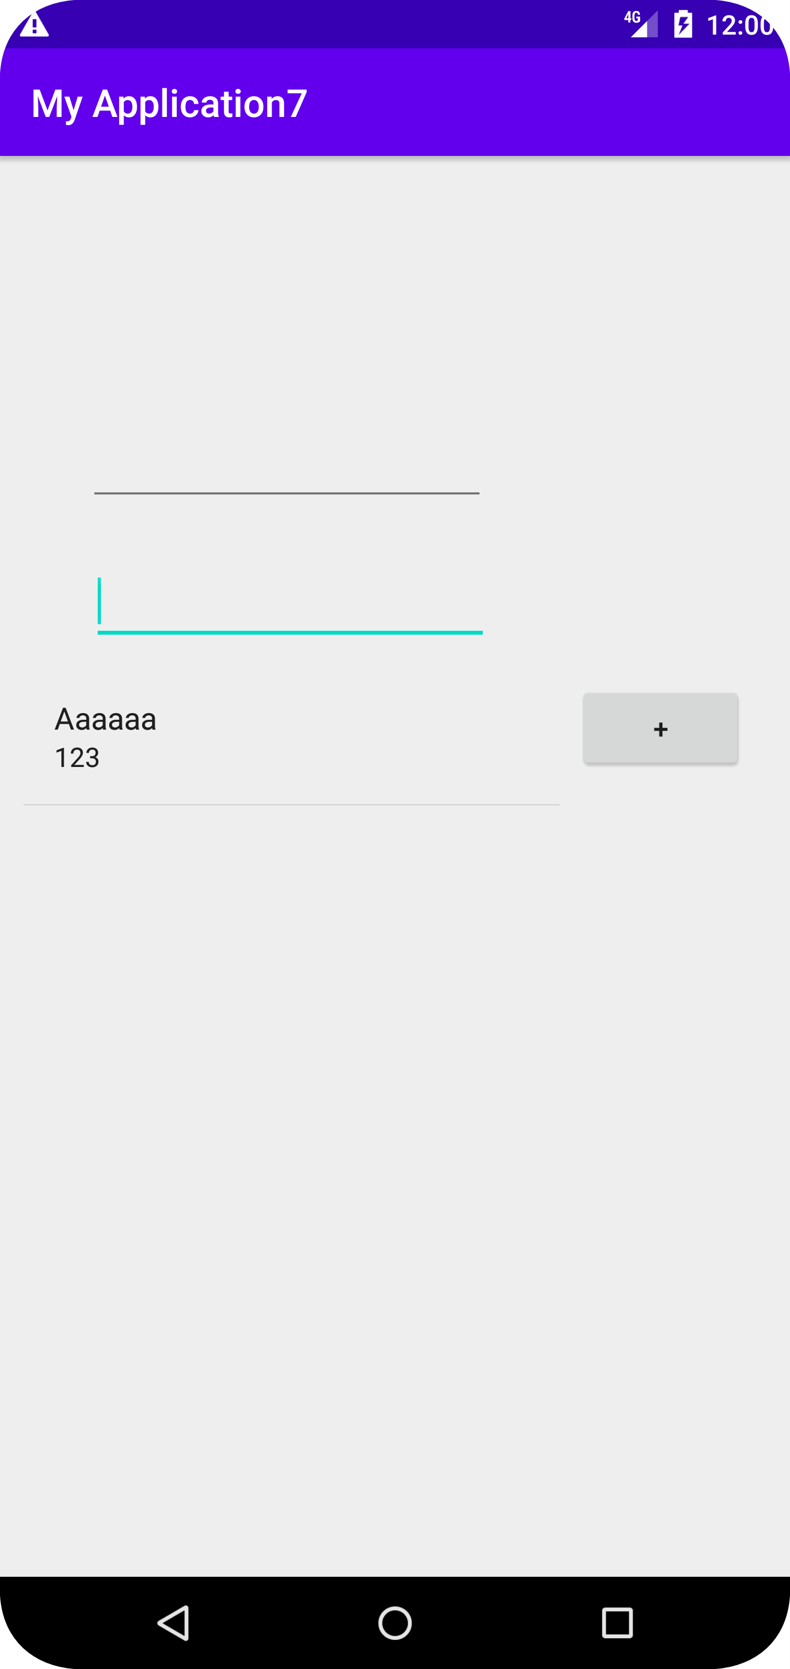
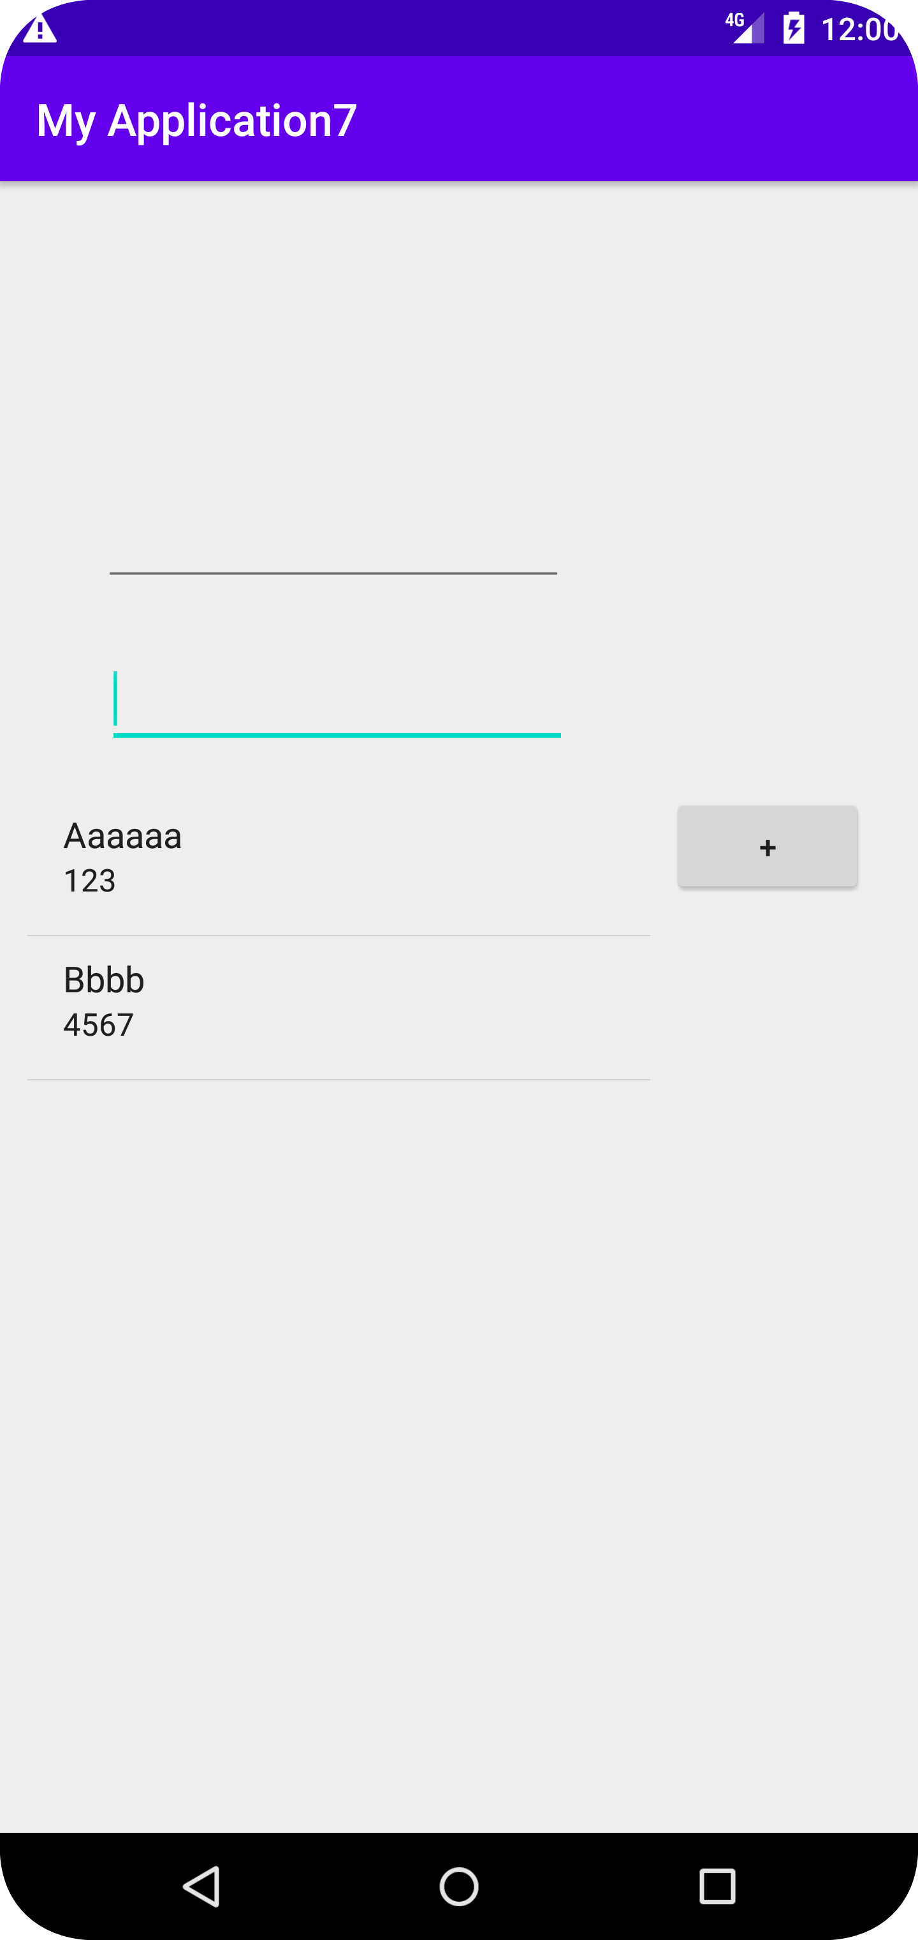
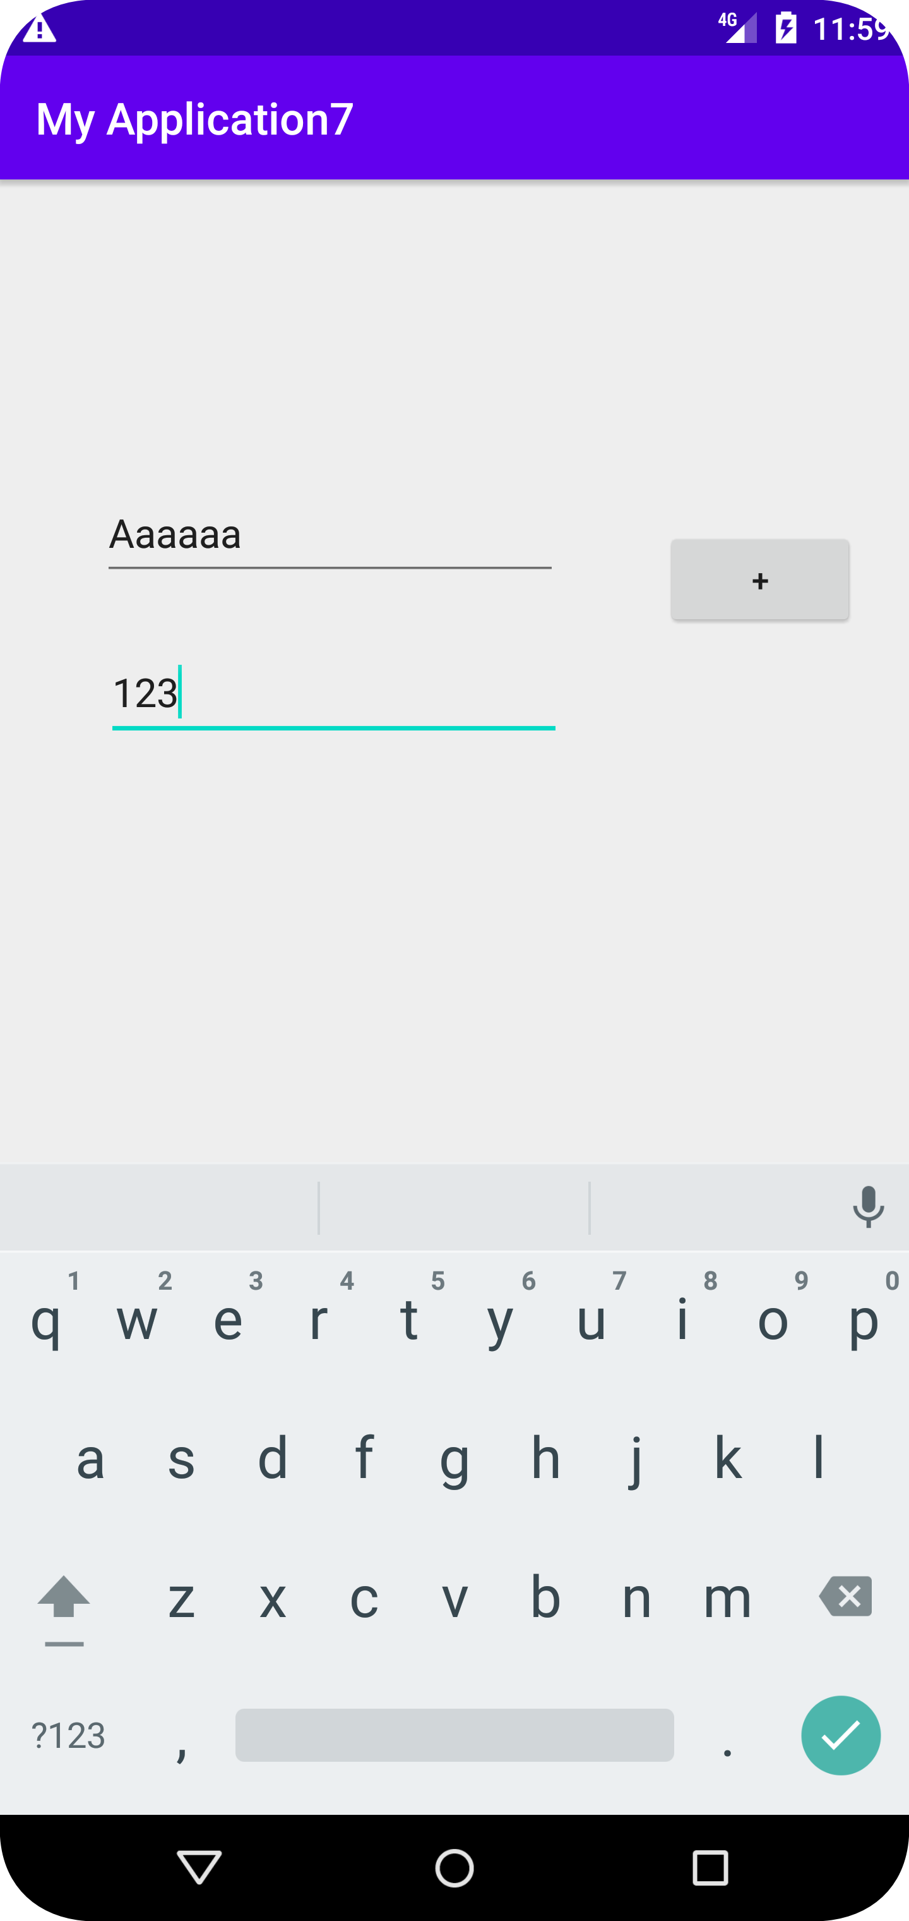
Application: Contact list

Slide 12
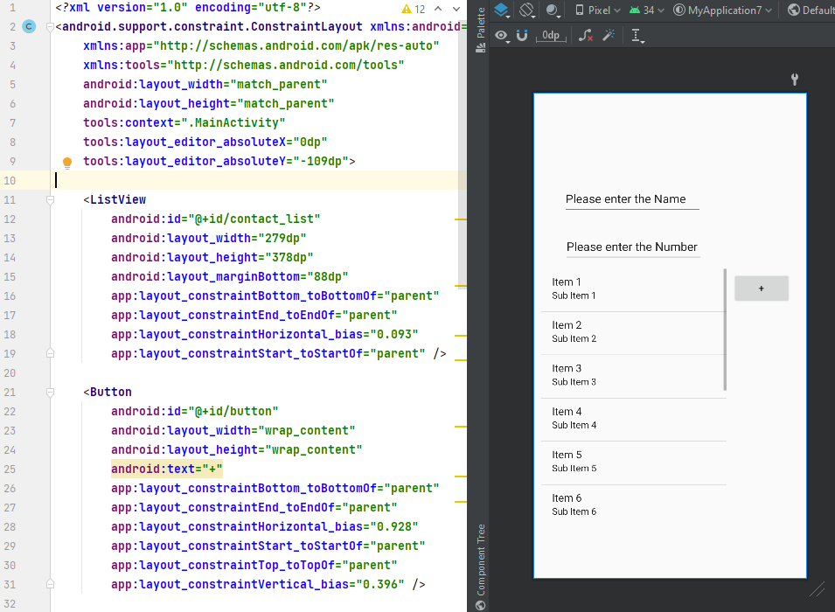
Application: Contact list

Slide 13
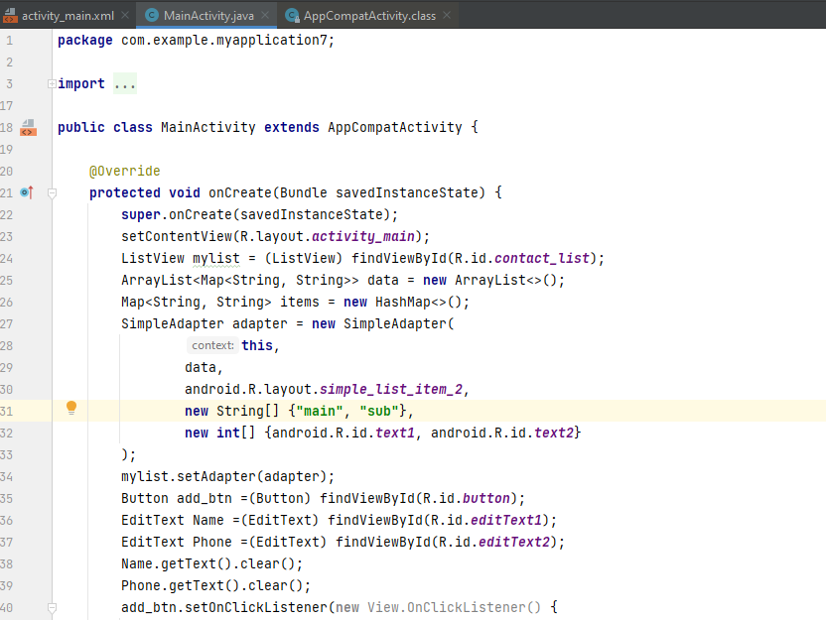
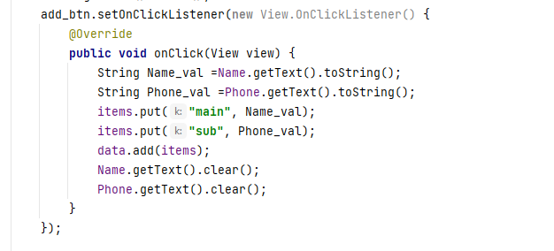

Slide 14
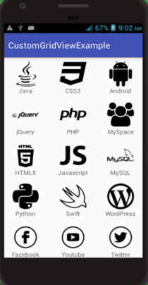
Grid View:
GridView is a ViewGroup that displays items in a two-dimensional, scrollable grid.

Slide 15
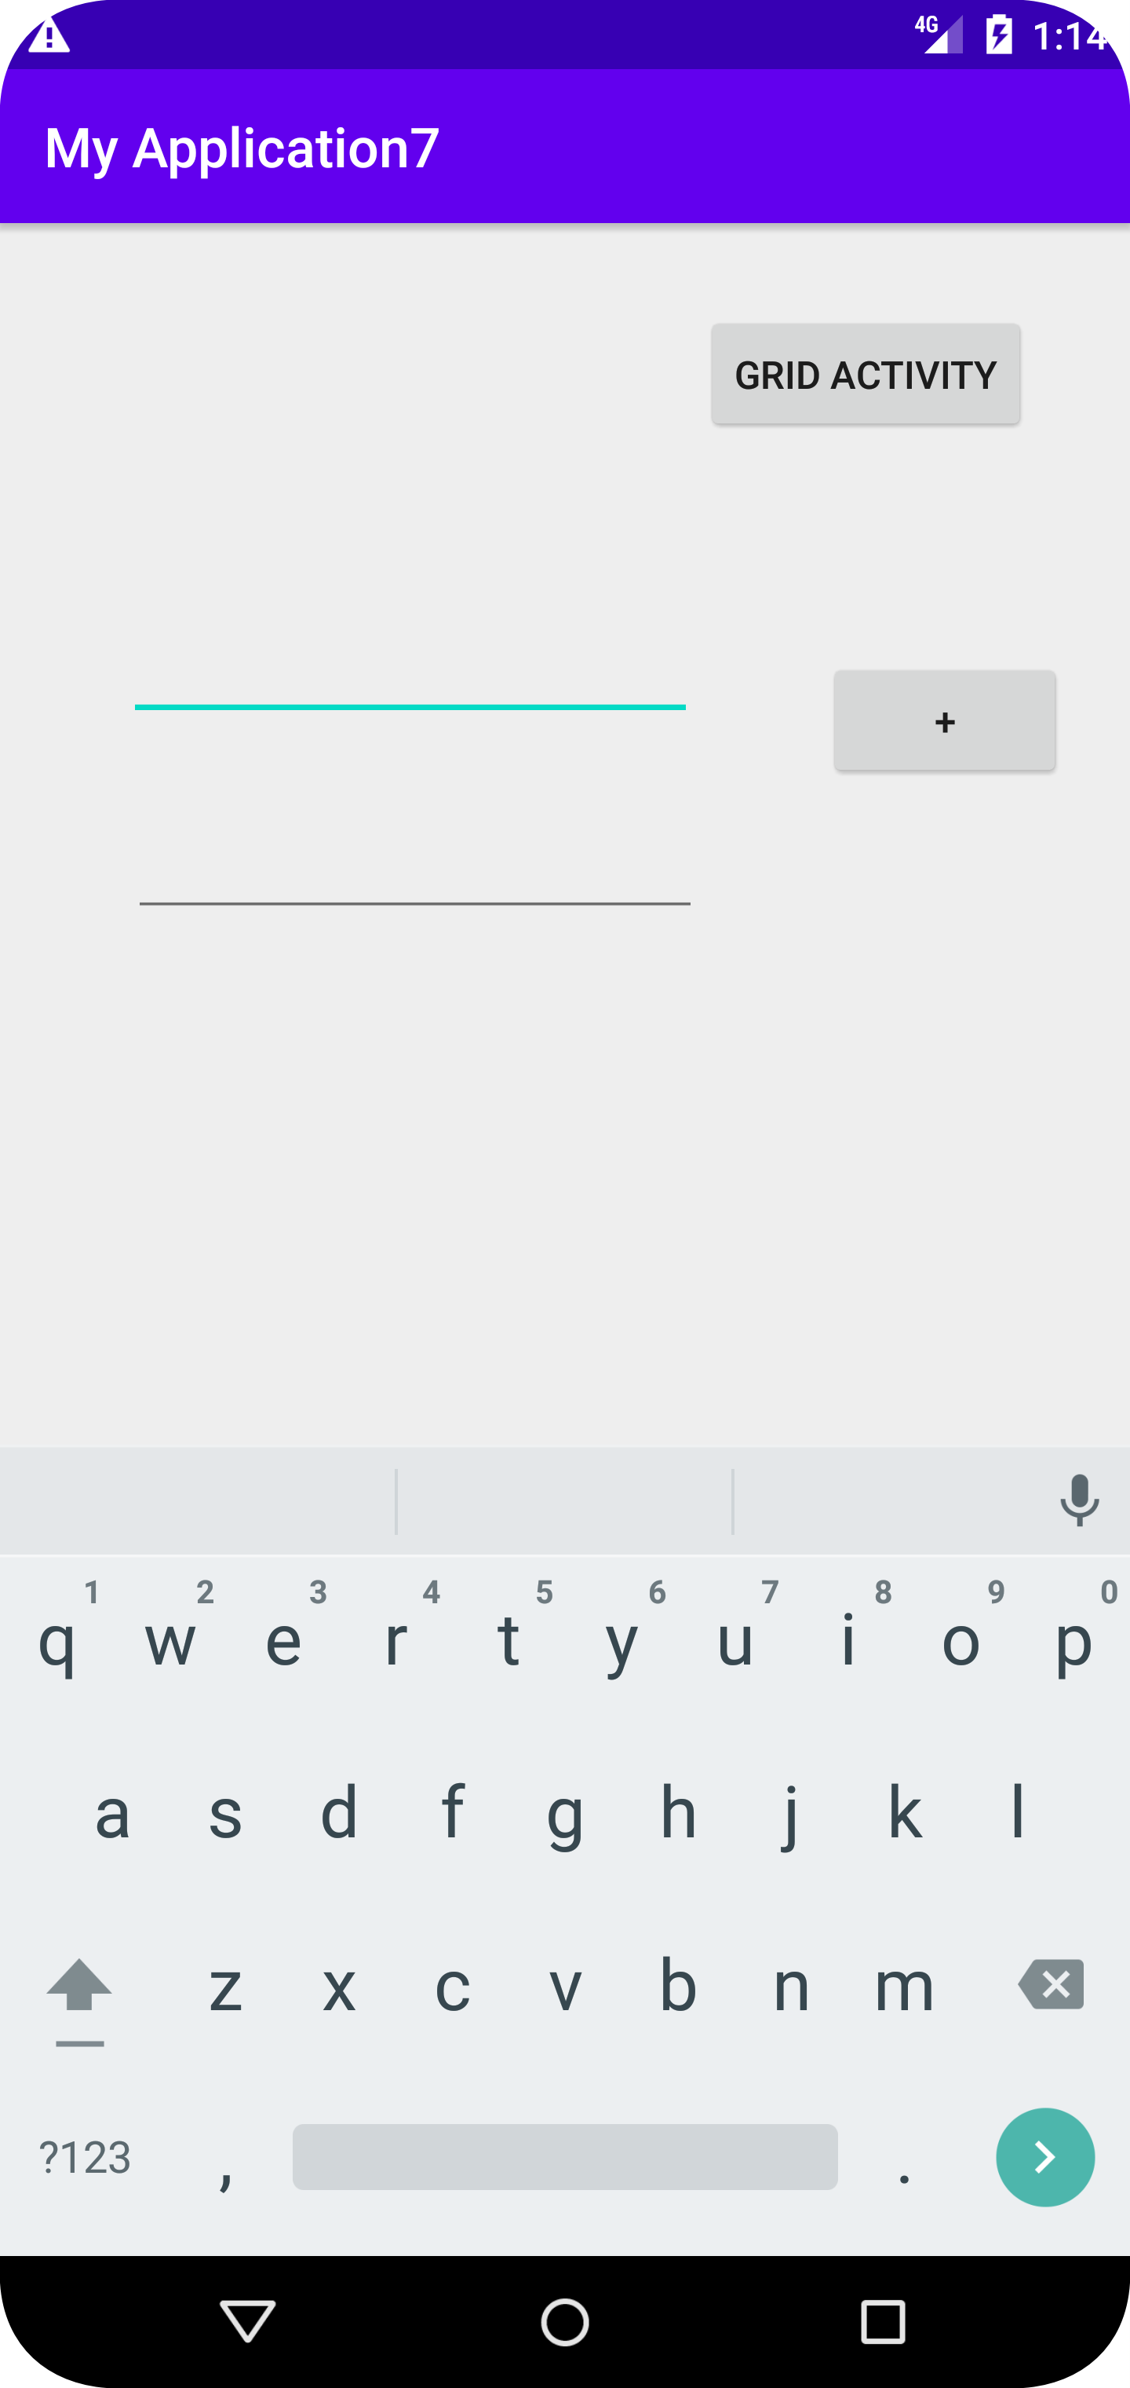
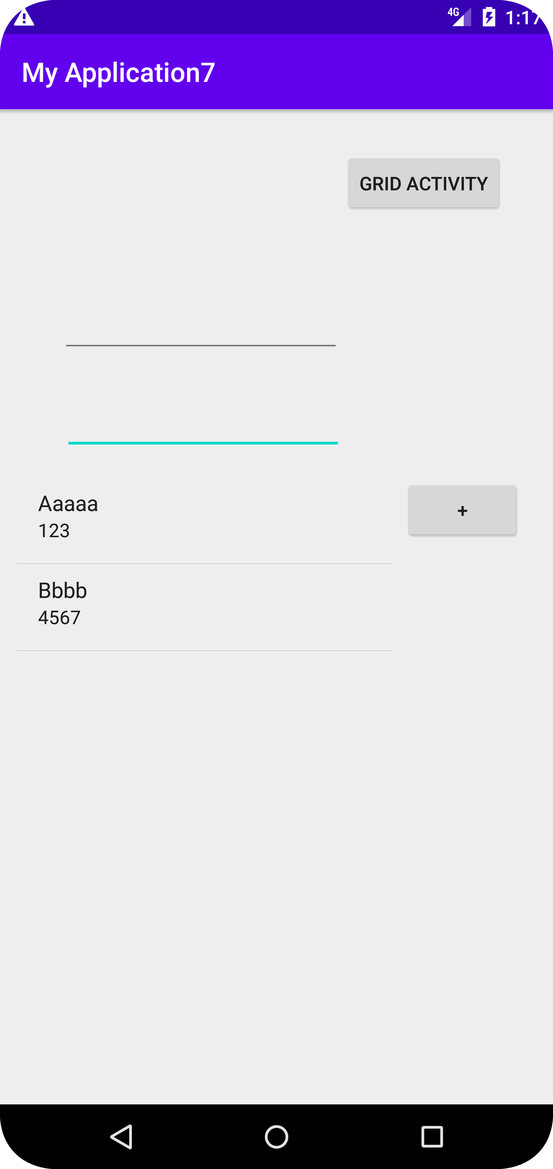
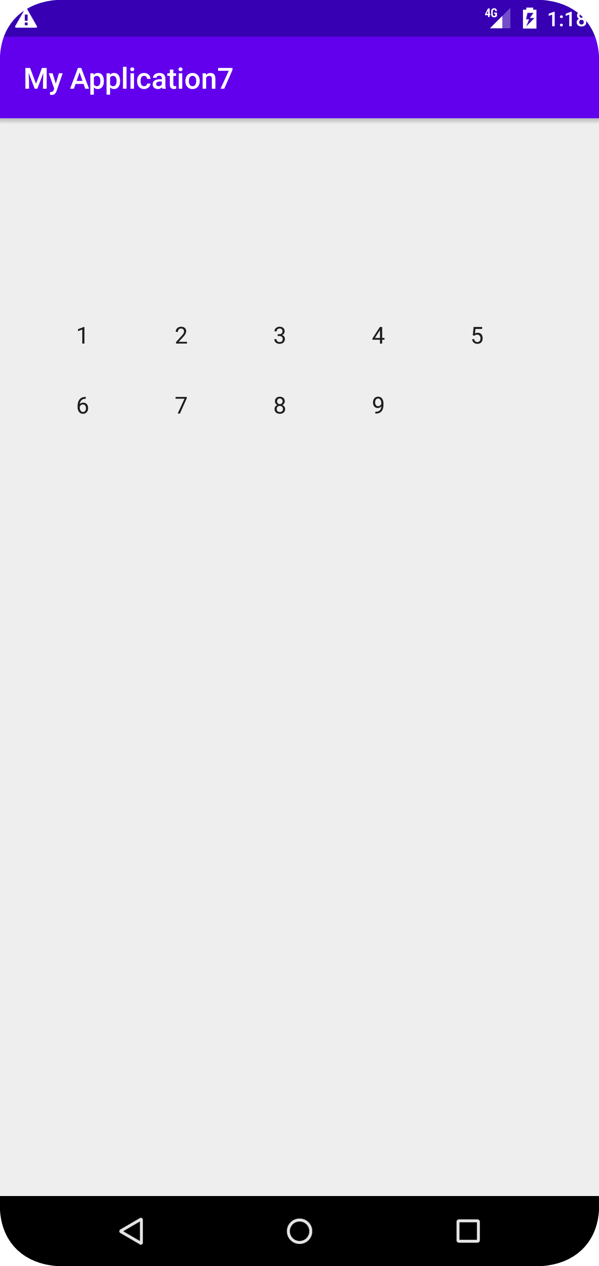
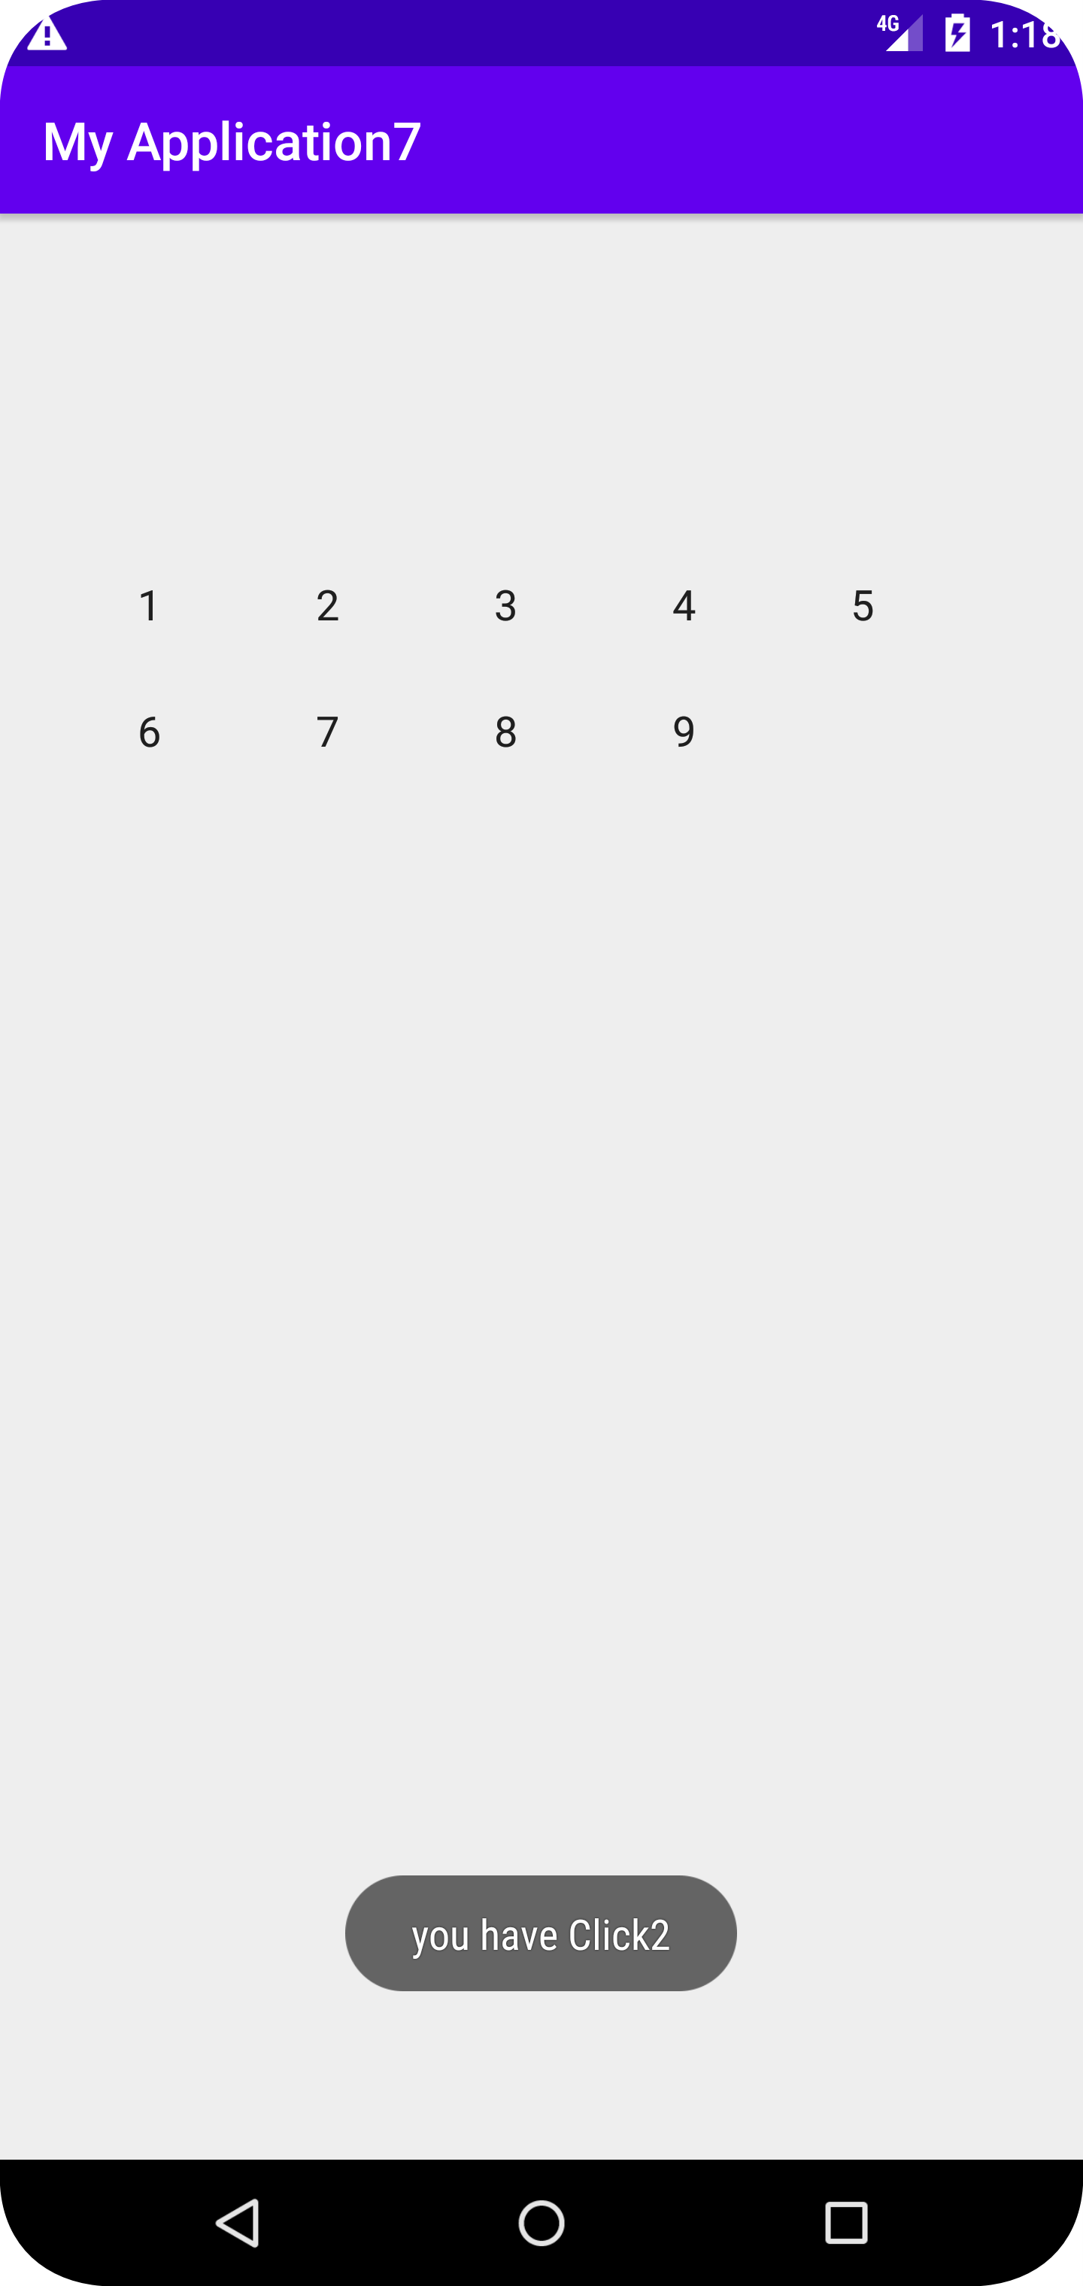


Slide 16
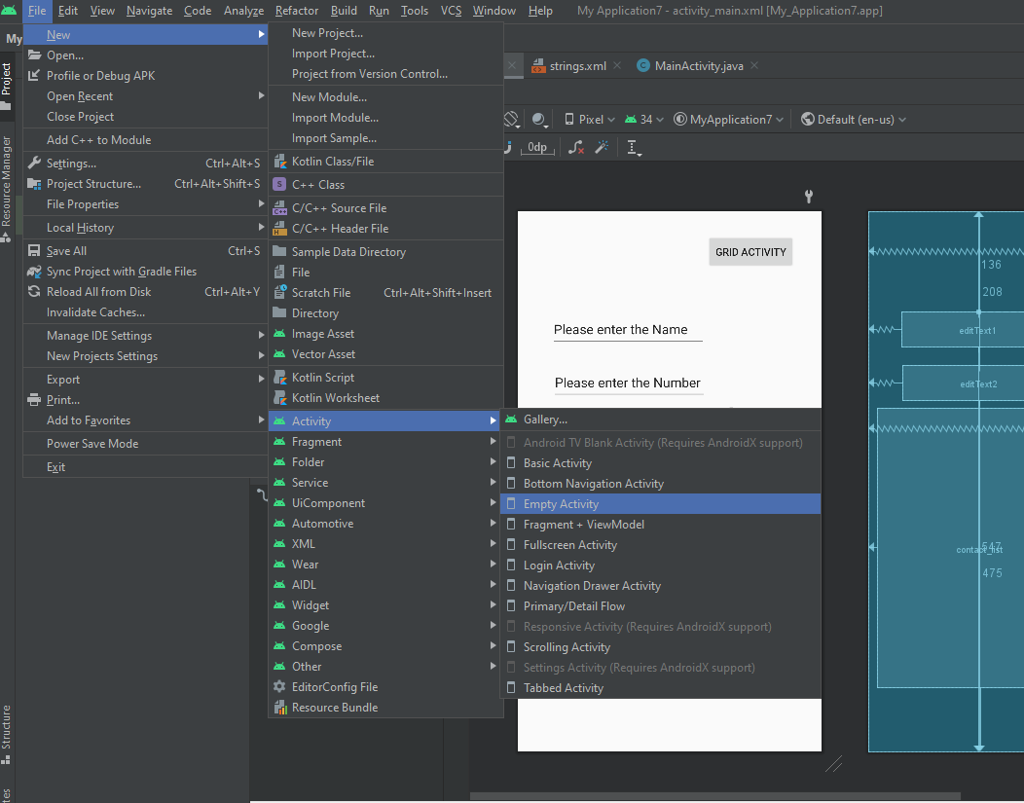
New Activity

Slide 17
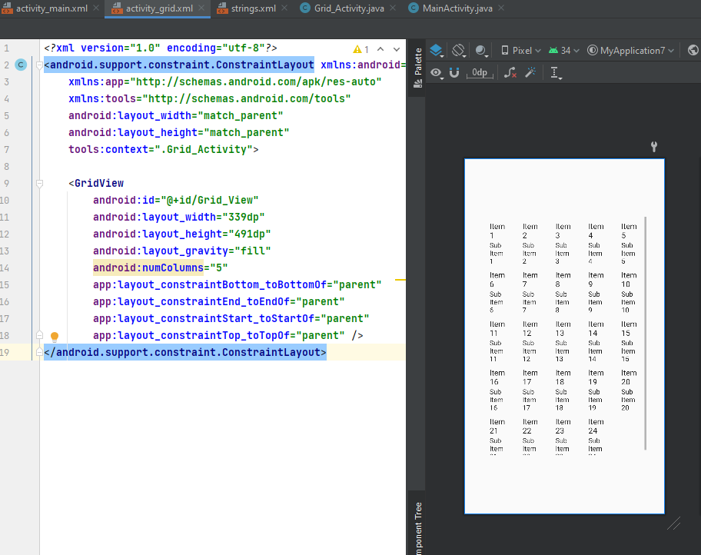

Slide 18
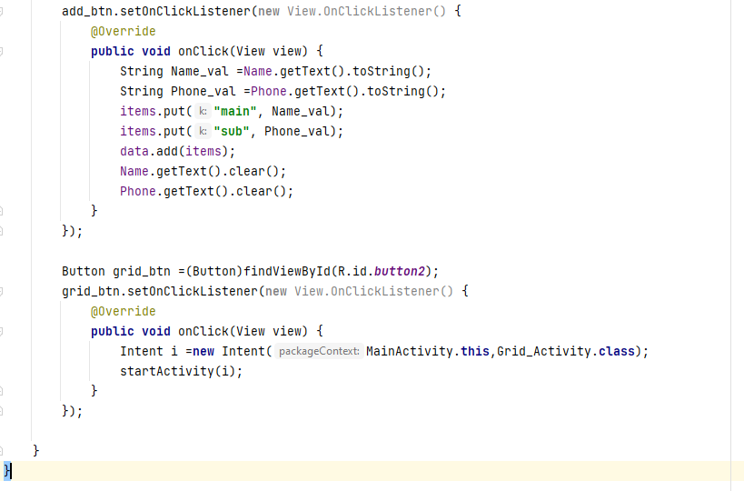
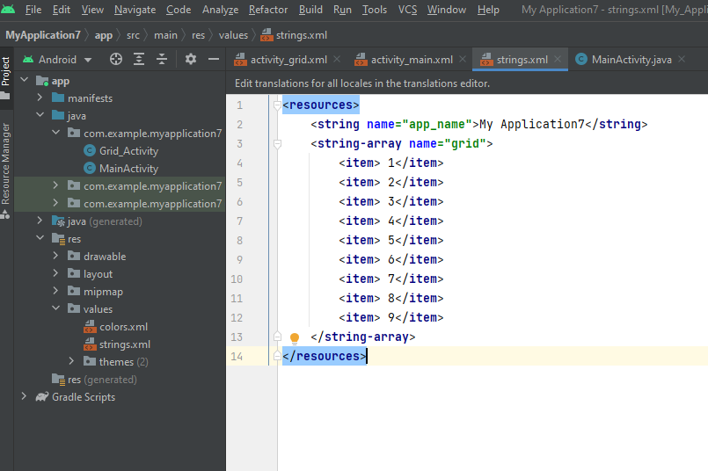

Slide 19
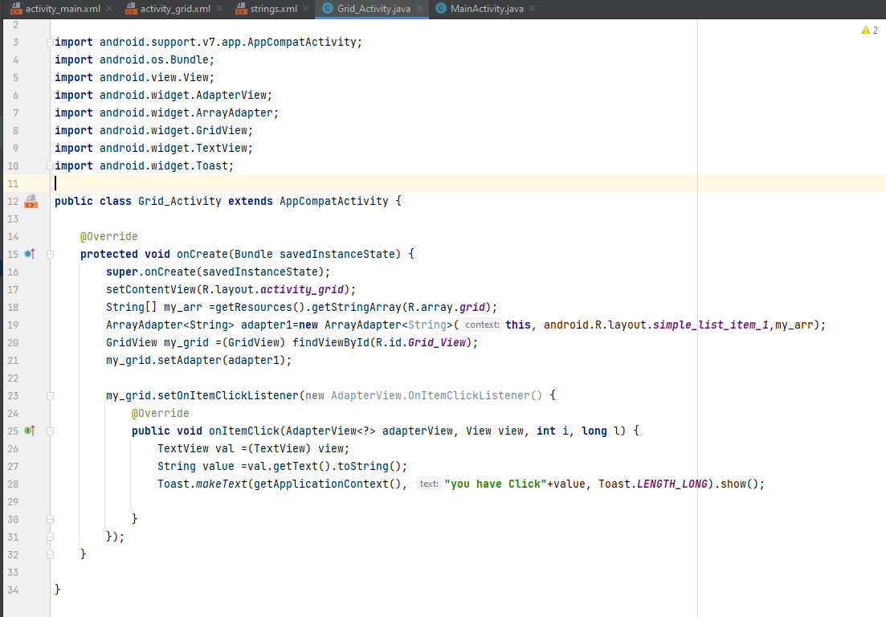

Slide 20
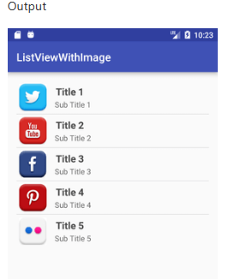
Assignment 1:Create custom List view items with name and description
Android Custom ListView (Adding Images, sub-title)
Example of Custom ListView:
In this custom listview for example, we are adding image, text with title and its sub-title.

Slide 21
Thank you!

